Slide 1
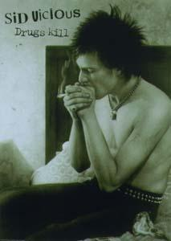
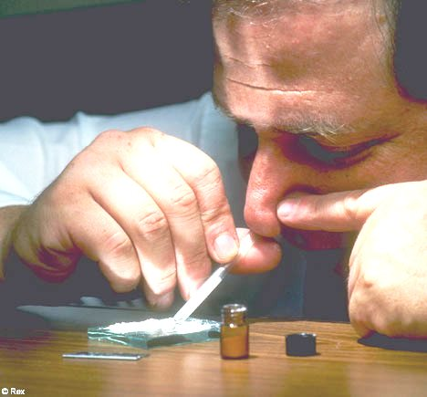
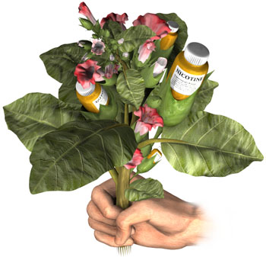
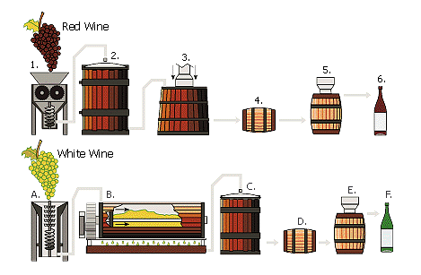
Social Work with Drug Addicts
IMRAN A. SAJID, PhD
imranahmad131@uop.edu.pk

Slide 2
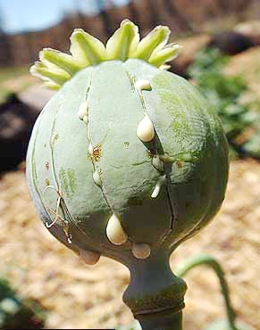
What is a Drug?
“any substance, natural or artificial, other than food, that by its chemical nature alters structure or function in the living organism”.
A drug is any substance that can be used to modify a chemical process in the body, for example to
(i) treat an illness,
(ii) relieve a symptom,
(iii) enhance a performance or ability, or
(iv) to alter states of mind.

Slide 3
The word "drug" is derived from the German word "droog", which means "dry", since in the past, most drugs were dried plant parts.

Slide 4
What is Drug Abuse?
The use of a drug for a purpose other than that for which it is normally prescribed or recommended.
The use of illegal drugs or the inappropriate use of legal drugs.
The repeated use of drugs
to produce pleasure,
to alleviate stress, or
to alter or avoid reality (or all three).

Slide 5
What is Drug Addiction??
The continued compulsive use of drugs in spite of adverse health or social consequences.
A behavioral pattern of drug use, characterized by overwhelming involvement with the compulsive use of a drug, the securing of its supply, and a high tendency to relapse after withdrawal.

Slide 6
Three Basic Processes of Drug Addiction
Tolerance:
reduced effect of a drug after repeated use. Or the need for an increase in the amount of drugs ingested to produce the same effect as before.
Physical Dependence:
Psychological Dependence

Slide 7
Types of Drugs
(aka sedatives) drugs or chemicals that decreases the activity of any bodily function. (barbiturates, Tranquilizers)
Depressants
any of a group of drugs that excite the central nervous system, increase alertness, and alleviate fatigue. (Caffeine, Cocaine, Crystalline
Stimulants
drugs that produce marked distortions of the senses and changes in perception. (marijuana, LSD,)
Hallucinogens
Pain-Killers
drugs taken to relieve discomfort. (e.g. Aspirin, Ibuprofen, Opium, Narcotics)

Slide 8
S.N. | Major Category | Drugs
A | Depressants | Alcoholic Beverages
 |  | Minor Tranquilizers – Benzodiazepines à Sleeping Pills
 |  | Barbiturates
 |  | Solvents and Gasses
 |  | GHB/GBH à Gammhydroxybutyrate
B | Pain Killers | Opiates
 |  | Natural Derivative of Opium poppy, heroin, morphine, codeine
 |  | Opoiodis --> Synthetic Drugs with effects similar to opiates
 |  | Narcotic Analgesics
C | Stimulants | Amphetamines
 |  | Cocaine
 |  | Caffeine
 |  | Tobacco --> Nicotine
 |  | Khat
 |  | Anabolic Steroids
 |  | Hallucinogenic Amphetamines
 |  | Alkyl Nitrites
D | Hallucinogens | LSD --> Lysergic Acid Diethylamide
 |  | Hallucinogenic Mushrooms
 |  | Cannabis/ Marijuana
 |  | Ketamine

Slide 9
Types of Addiction
Intoxicated Addiction
Medicated Addiction

Slide 10
Classes of Drugs
Depressants: (aka sedatives) drugs or chemicals that decreases the activity of any bodily function. (barbiturates, Tranquilizers)
Stimulants: any of a group of drugs that excite the central nervous system, increase alertness, and alleviate fatigue. (Caffeine, Cocaine, Crystalline)
Hallucinogens: drugs that produce marked distortions of the senses and changes in perception. (marijuana, LSD,)
Pain-Killers: drugs taken to relieve discomfort. (e.g. Aspirin, Ibuprofen, Opium, Narcotics)

Slide 11
Impacts of Drug Addiction
Psychological Impacts
Social Impacts
Economic Impacts
Physiological Impacts

Slide 12
Social work defined
Social work is the professional activity of helping individuals, groups, and communities to enhance or restore their capacity for social functioning* and to create societal conditions favourable to their goals.
National Association of social workers USA
*The ability of a person to interact easily and successfully with other people.

Slide 13
Methods
Social Case Work
Social Group Work
Community Organization
Social Welfare Administration
Social Policy and Action
Social Work Research

Slide 14
Social Work Intervention to Drug Addiction
Primary Prevention
Awareness
Secondary Prevention
Treatment
Tertiary Prevention
Rehabilitation
An action that stops something from happening

Slide 15
Primary Prevention
Primary prevention in social work means to control the situation before existence of the problem
Awareness
Education
Awareness
Education

Slide 16
Secondary Prevention (Treatment)
Medication (detoxification)
Counseling
*advice sought from or given by somebody, especially somebody who is wise or knowledgeabl

Slide 17
Tertiary Prevention
Rehabilitation
It is the adjustment between the client and his community

Slide 18
Q/A
Methods of Social Work
Medical Social Work
Social Work with Drug Addicts
Your Presentations

